Slide 1
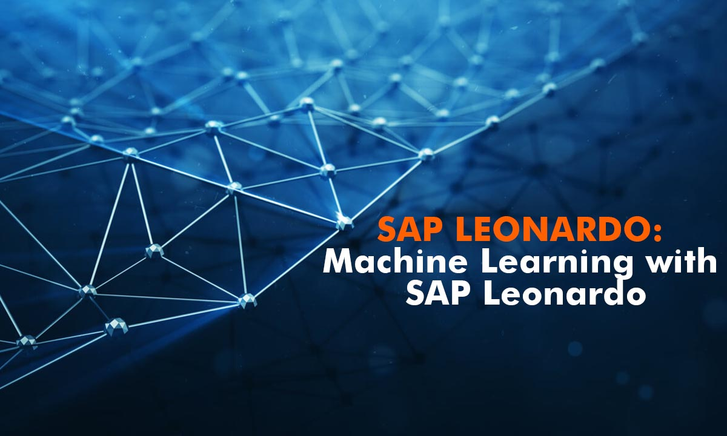

Slide 2
SAP Leonardo
SAP launched its Leonardo platform as a “digital innovation system” in June 2017.
SAP Leonardo is a combination of intelligent technologies, services and industry expertise that can help you optimize your processes and resources and innovate in all areas of your business.
SAP Leonardo in its most simplistic form is SAP’s innovation platform.
SAP S4/Hana (cloud or on-prem) is your ECC/Core system of record going forward and Leonardo will be the innovation platform that sits on top called your “System of Intelligence”.
Most of the SAP Leonardo technologies and services exist today in the SAP Cloud Platform, however Leonardo is formalizing and grouping these technologies into tailored solutions for business scenarios.

Slide 3
It is the world’s only digital innovation system, which combines Design Thinking services, Machine learning, Big Data, IOT, Data Intelligence, Block Chain and Analytics to run the enterprise smarter, smoother and completely digital.
Design thinking services- Enables users to build future digital enterprise
Machine learning- provides the computers the ability to learn without being explicitly programmed.
Big Data - Manage vast amounts of data
IOT (Internet of Things)- Internet of computing devices embedded in everyday objects
Block Chain - increase auditability and decrease fraud
Data Intelligence & Data Analytics
All the above technologies will be integrated to SAP Cloud Platform.
The world is transforming digital day to day. By combining all these technologies SAP Leonardo is going make any Enterprise of any industry run completely digital and powerful without any hassles.

Slide 4
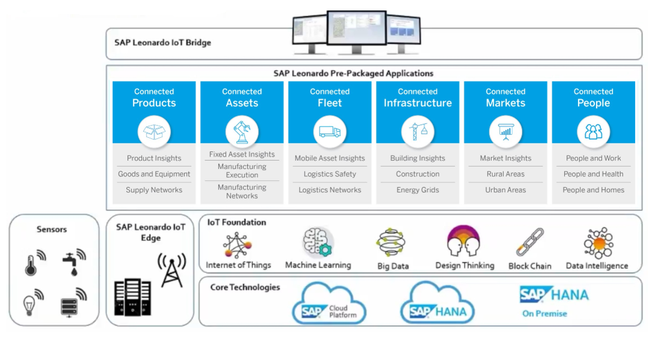
SAP Leonardo Architecture

Slide 5
There are 5 main components of SAP Leonardo
SAP Leonardo for Edge Computing : A physical Edge Processing device is often referred to as IoT gateway. SAP released an IoT solution called SAP Dynamic Edge Processing. SAP dynamic Edge Processing enables companies to process much of their IoT data locally.
SAP Leonardo Foundation : SAP Leonardo Foundation enables companies to ''prepare'' IoT data for usage in apps and reports.
SAP HANA Cloud Platform : SAP HANA Cloud Platform enables companies to perform real-time analyses, use IoT data in custom apps and take advantage of innovative micro services like machine learning.
SAP Leonardo Applications : SAP Leonardo Applications are standard applications to use in customer specific IoT scenarios.
SAP Leonardo Bridge : The gap between real-time information from connected things on the one hand and the business processes on the other is filled with the SAP Leonardo Bridge.

Slide 6
SAP Landscape Management

Slide 7
SAP LaMa
SAP Landscape Management (SAP LaMa) - formerly known as SAP Landscape Virtualization Management (SAP LVM) - is a powerful landscape administration solution that helps businesses reduce their cost of operations and increase their business agility through:
Automation of repetitive, time consuming system administration tasks
Centralized landscape management, operations and visibility
Acceleration of fundamental business application lifecycle operations
Advanced operations specifically for SAP systems powered by SAP HANA
The last version of LVM is 2.1, beginning with version 3.0 the product is called SAP LaMa.
With SAP Landscape Management software (LaMa), you can simplify and automate the management and operations of your SAP systems running on traditional, virtual or cloud infrastructures.

Slide 8
The LaMa software itself is shipped as an add-on to SAP NetWeaver (Application Server Java) and the minimum requirement is SAP NetWeaver 7.50 SP04 or higher.
SAP Landscape Management software is a licensed product and the product is available in two editions: Standard edition and Enterprise edition.
Standard edition is available to all SAP customers with at least one active SAP application license and has no license cost associated with it. The customer will have to obtain a license for Standard Edition but, do not have to incur any additional cost.
Enterprise edition is available to all SAP customers as a separately licensed product.
Following are some of the business benefits of SAP LaMa :
Greater operational continuity through centralized management, visibility and control of your entire SAP landscape using a single console.
Reduced time, effort and cost to manage and operate your SAP systems through automation of time-consuming basis administration tasks.

Slide 9
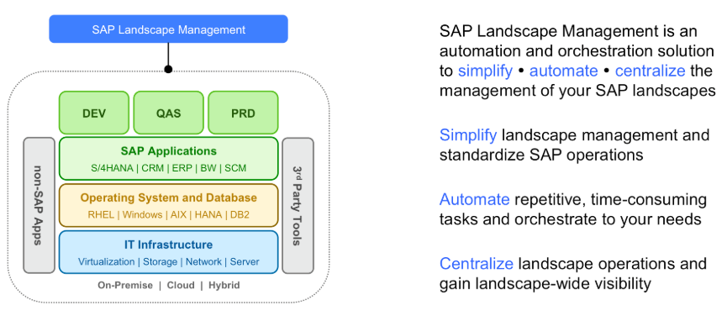
Overview

Slide 10


Slide 11
SAP FIORI
SAP Fiori is the new user experience (UX) for SAP software.
Introduced in 2013, SAP Fiori has evolved from a collection of apps into the new user experience for SAP software.
It provides a broad range of apps that can be ported to desktops, tablets, or any mobile device to simplify tasks of end users.
SAP Fiori provides 300+ role-based applications like HR, Manufacturing, finance, etc.
SAP Fiori provides all business roles in real time on compatible hand devices.
SAP Fiori enables multiple device applications that allow users to start a process on their desktop/laptops and to continue that process on a smartphone or on a tablet.
SAP has developed Fiori Apps based on User interface UI5.
SAP Fiori 2.0 was launched in October 2016. It represents the newest evolution of the user experience for SAP S/4HANA and SAP Business Suite.

Slide 12
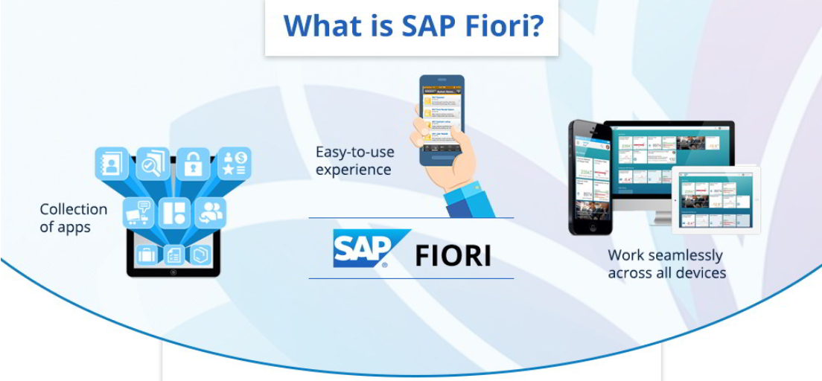

Slide 13

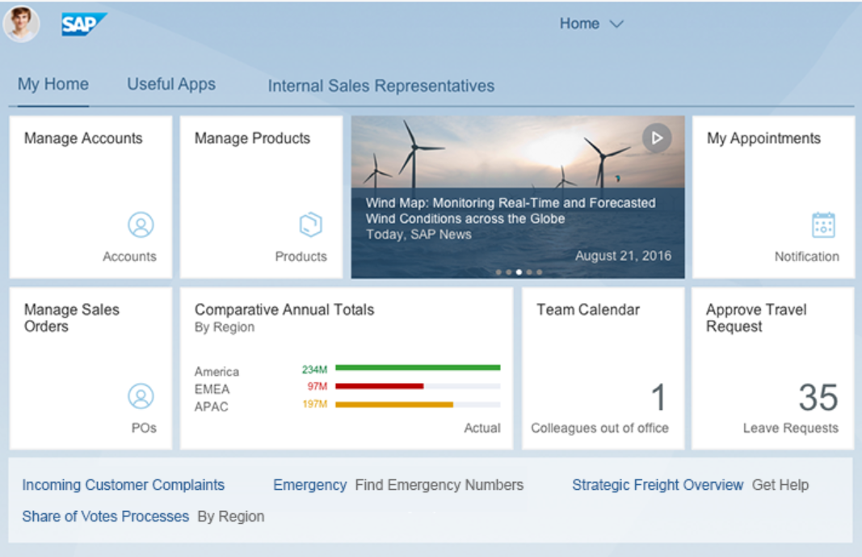
SAP Fiori Launchpad Home Page
The SAP Fiori launchpad home page is the first page that users see after they have logged in.
It is the main entry point to SAP Fiori apps on mobile and desktop devices.
The launchpad home page displays tiles and links that allow the user to launch apps, and may also show additional information.
The page can be personalized and apps can be added, removed, or bundled in groups.

Slide 14
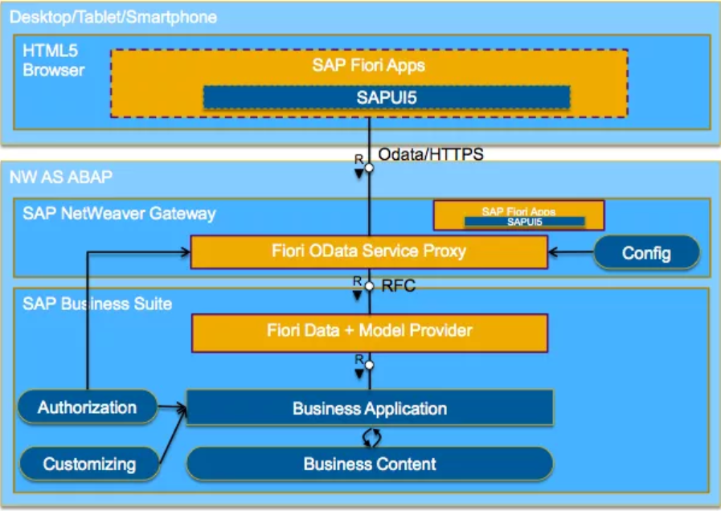
SAP FIORI Architecture
Fiori applications interact with database with the help of Net weaver gateway.
MVC is implemented in building Fiori Apps.
The Meaning for MVC architecture is Model, View, Controller in model deals with data base operations.
View represents the screen element like table, text, radio button, combo box, shell etc.
Controller acts as a mediator between model and view for sending and receiving data by consuming odata service.
Controller contains implementations under Event Handlers and also it contains front end validations.

Slide 15
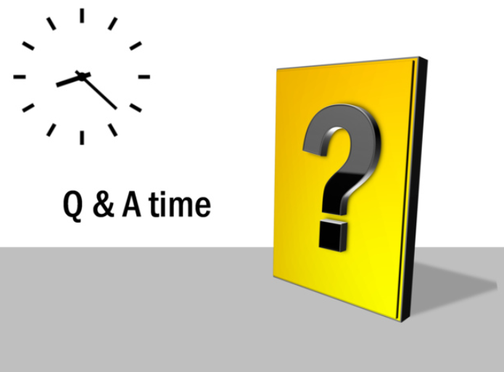

Slide 16


